Slide 1

DEPARTMENT OF INFORMATICS, SYSTEMS AND COMMUNICATION
DATA MANAGEMENT PROJECT
GAMES AND REVIEWS: HOW THEY ARE CONNECTED?
PAOLO CAGGIANO - DAVIDE GIARDINI

Slide 2
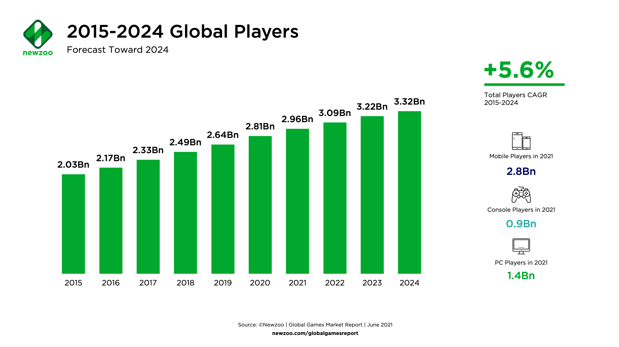
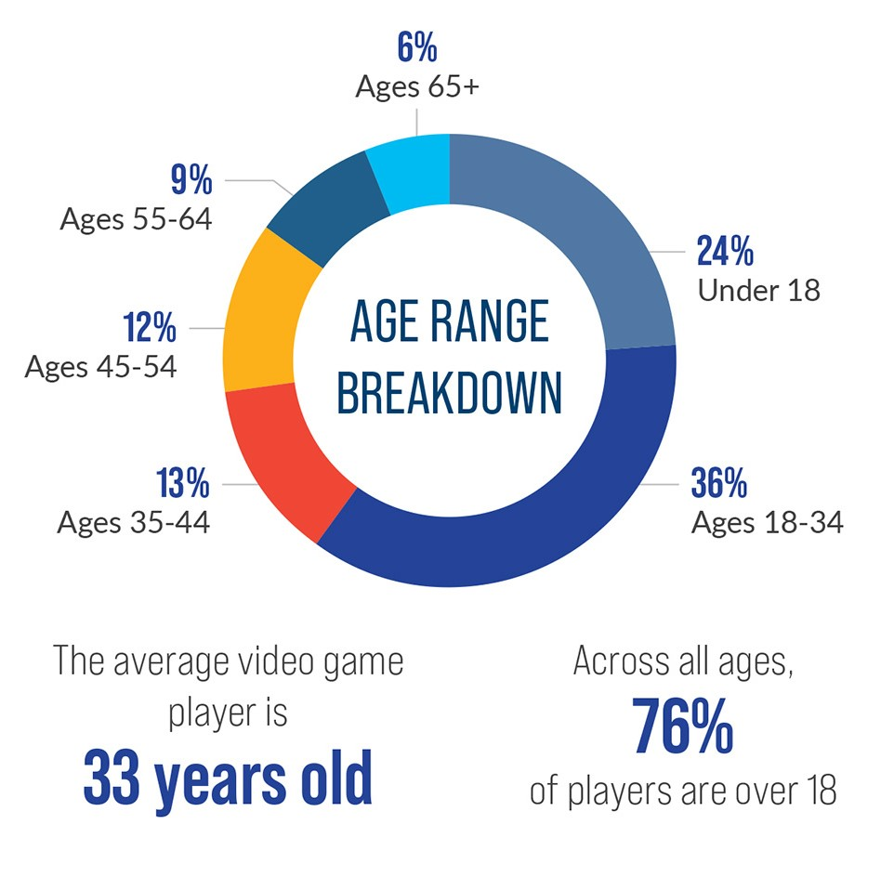
INTRODUCTION

Slide 3
BUSINESS UNDERSTANDING
How do you make a good game, both in user’s review and profit terms, in an industry with this competition?
It is clear, in this type of environment, reviews are extremely important.
But how much important?
Are professional critic’s reviews the main factor of a game’s success?
Are user’s reviews what count the most?
How much are the reviews important in terms of success or failure of a game?
Are there genres more attractive than others in terms of reviews?
Which are the most expensive genres?

Slide 4
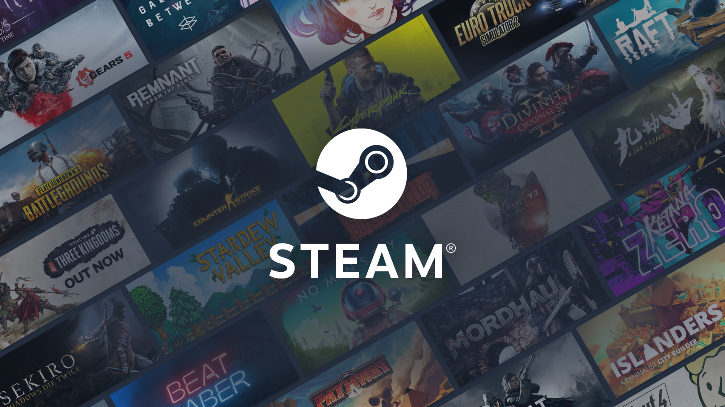

DATA ACQUISITION
Title
Position on the ranking
Release date
Price
Steam code
Number of reviews made by the users
Ratio of positive reviews
Ratio of negative reviews
Genres
Title
Metascore
Release date

Slide 5

DATA STORAGE
Schema Free
Flexibility

Slide 6
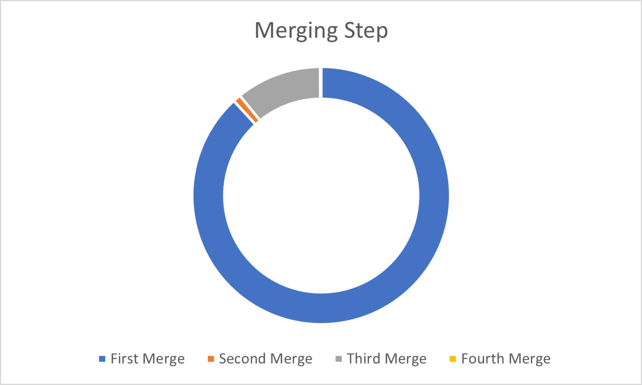
DATA INTEGRATION
- DATA CLEANING - DATA MERGING

Slide 7
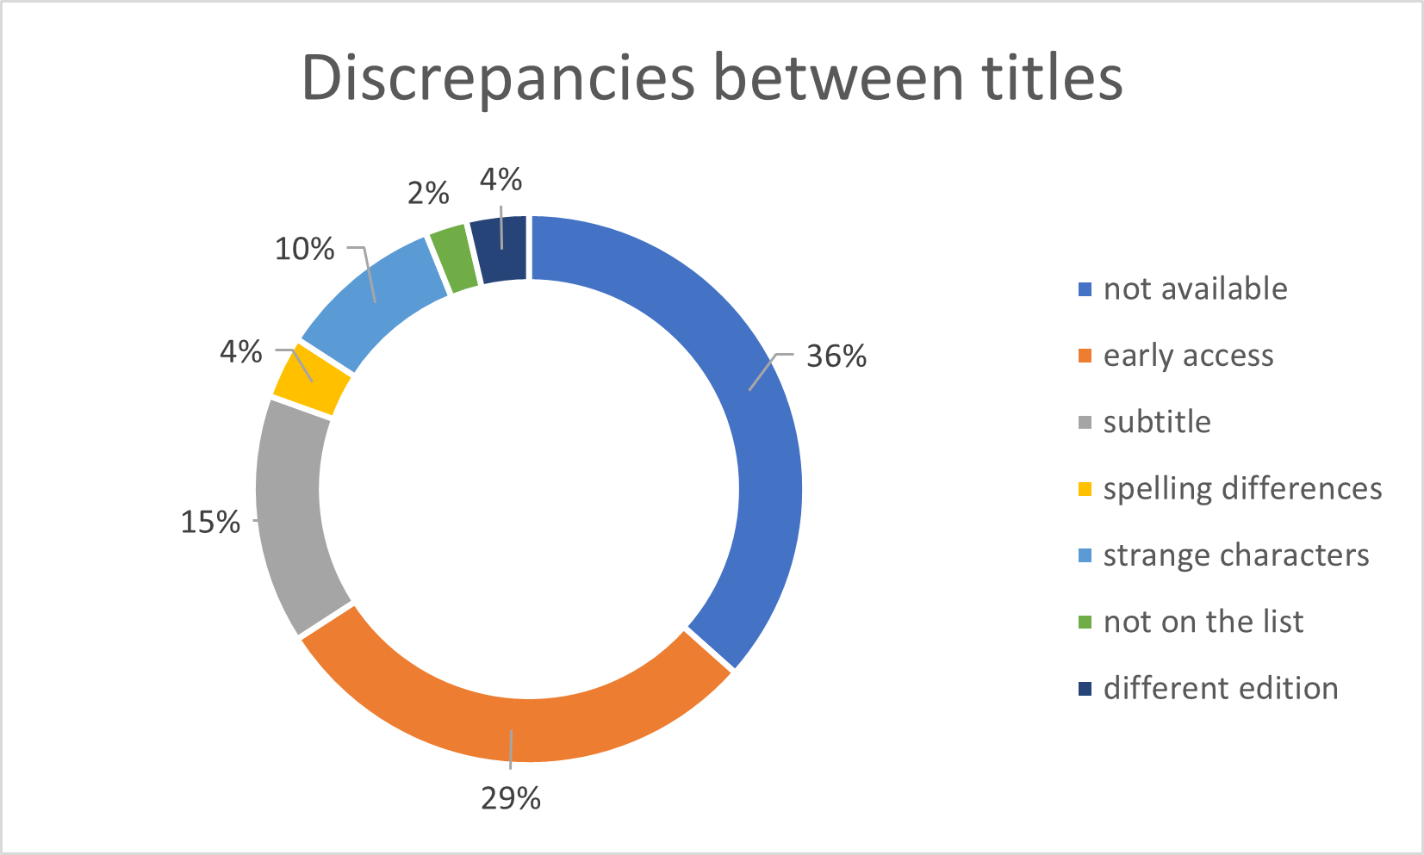
DATA QUALITY
COMPLETENESS
CONSISTENCY
TUPLE COMPLETENESS:
Six games without user reviews’. Null values.
OBJECT COMPLETENESS:
5209 games that were available on Steam global top selling page.
Final dataset includes 3113 of them (60%).
Of the remaining 2096 games, 1279 didn’t have a Metacritic review. The goal of the consistency analysis was to investigate why the others 817 games didn’t have a correspondence. So, to do this, we have extracted a random sample of 10% of the 817 games.

Slide 8
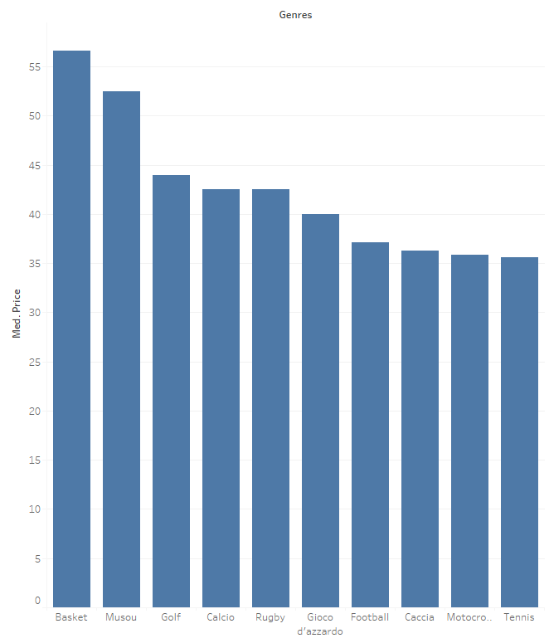
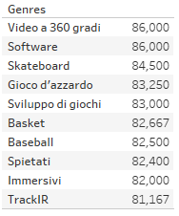
EXPLORATORY DATA ANALYSIS
Medium score

Slide 9
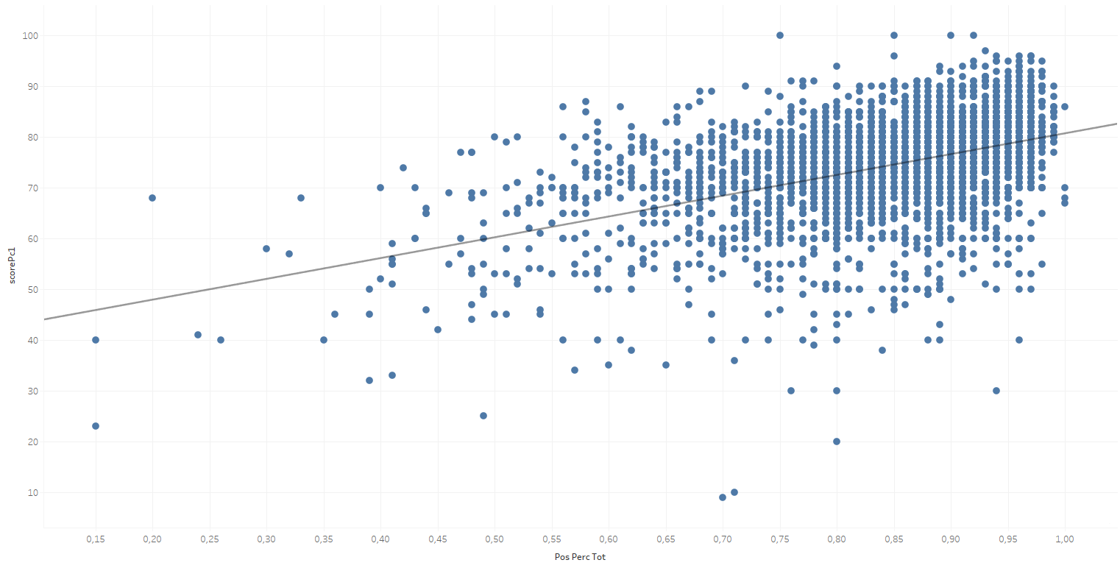
USERS’ SCORE vs CRITICS’ SCORE

Slide 10
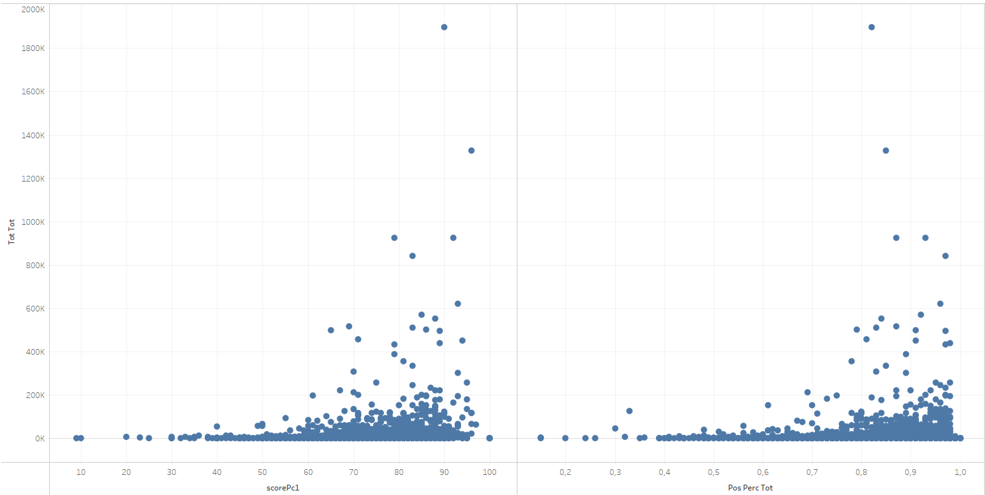
REVIEWS vs NUMBER OF DOWNLOADS

Slide 11
THAT’S ALL FOLKS!

